Slide 1
Temperature Forecasting
DATS 6313: Time Series and Analysis
Fall 2023
December 11, 2023
By
Shubham Jadhav G30570862

Slide 2

Table of Contents
Problem Statement
Data Description
Stationarity
Time Series Decomposition
Holt-Winters Method
Base Models
Multi Linear Regression
ARMA Model
Final Model selection
h-step ahead Predictions

Slide 3
Objective

Slide 4
Objective
To create a model to forecast temperature based on the features present in the dataset i.e., sensor data.
To perform Time Series Analysis on the selected dataset.
To evaluate model performance based on various parameters

Slide 5
Data Description

Slide 6
Data Description
The Occupation dataset consists of contains data collected from an office room over a period of 7 days.
The dataset was collected by using several sensors.
9752 observations and 7 numerical features.
Features include time, temperature, humidity, light intensity, CO2 levels, humid- ity ratio, and occupancy.

Slide 7
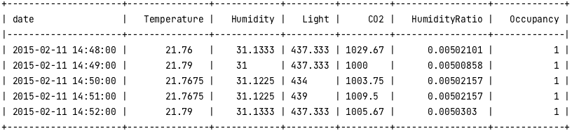
Sample observations from dataset

Slide 8
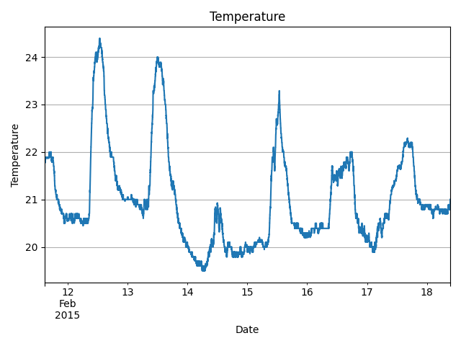
Temperature over time

Slide 9
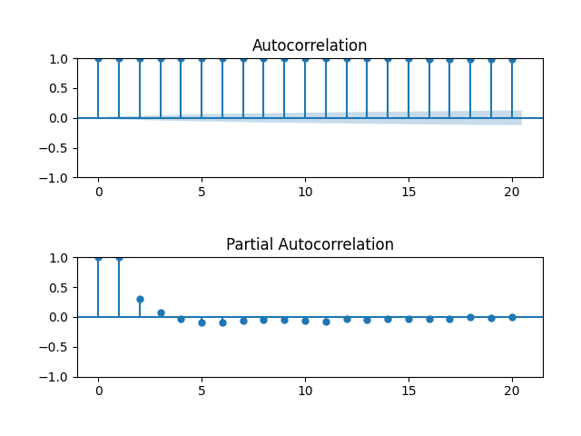
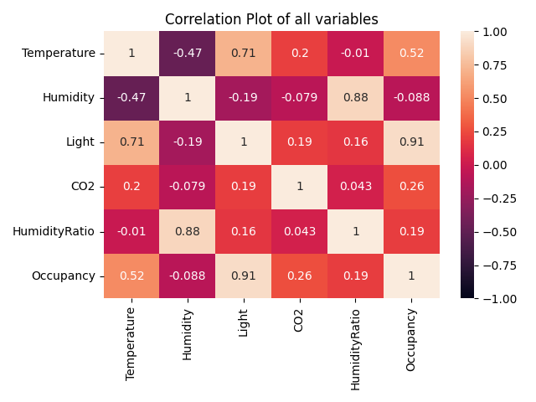
ACF/PACF and Correlation plot

Slide 10
Stationarity

Slide 11
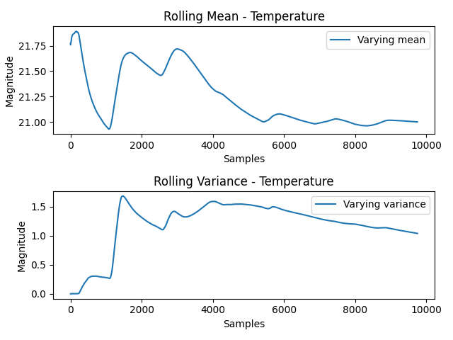
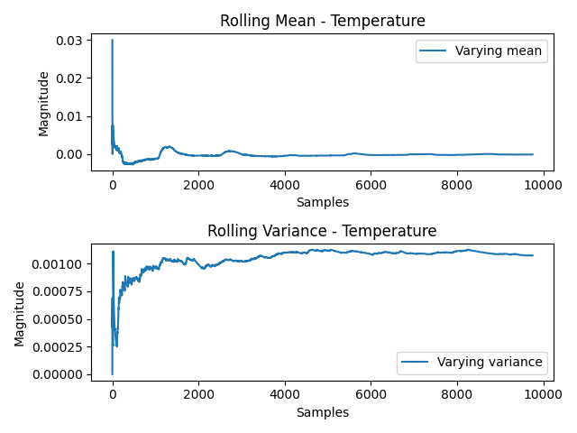
Rolling Mean and Variance

Slide 12
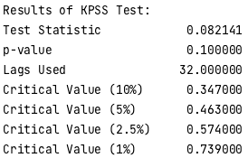
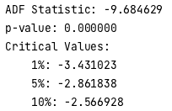
ADF and KPSS Test Results
According to ADF test p-value is less than 0.05, hence the time series is Stationary.
According to KPSS Test p-value is greater than 0.05, hence the time series is Stationary.

Slide 13
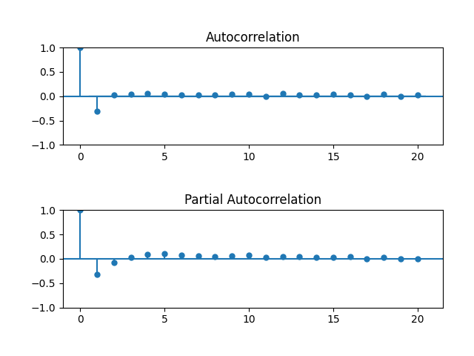
ACF/PACF plot of Stationary Data
We can observe from the ACF/PACF plot that differenced data is now stationary.

Slide 14
Time Series Decomposition

Slide 15
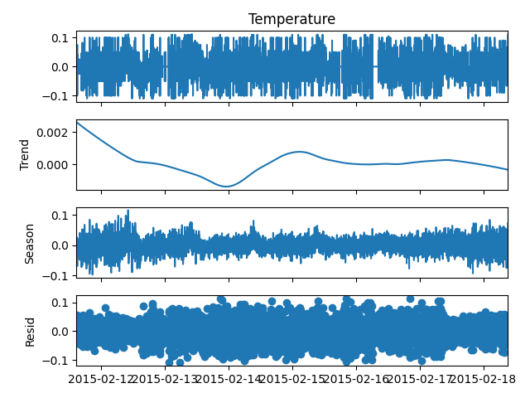
Time Series Decomposition
The strength for this data is 0.0012 or 0.12% which is very low.
The strength of this is 0.4107 or 41.07% which is significant.

Slide 16
Holt-Winters Method

Slide 17
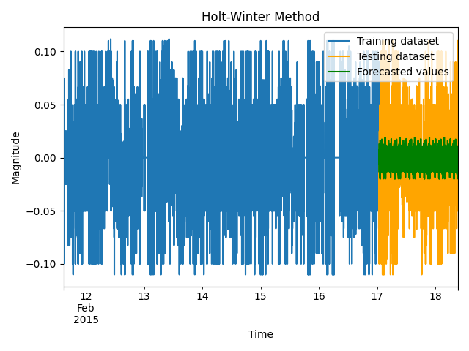
Holt-Winters Method
Q-Value: 957.818 (Critical: 36.19)
Mean of residual error: 0
MSE of residual error: 0.001
Mean of forecast error: 0.002
MSE of forecast error: 0.001
Variance of residual errors versus forecast errors: 1.13

Slide 18
Base Models

Slide 19
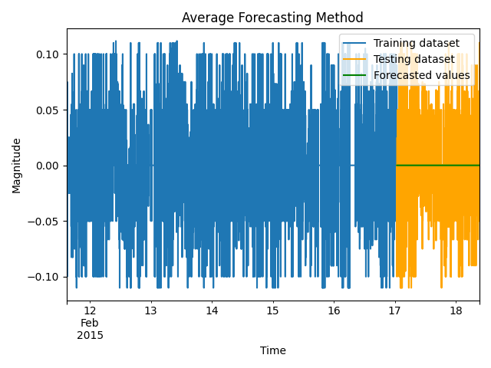
Average Method
Q-Value: 968.28 (Critical: 36.19)
Mean of residual error: 0
MSE of residual error: 0.001
Mean of forecast error: 0.004
MSE of forecast error: 0.001
Variance of residual errors versus forecast errors: 1.14

Slide 20
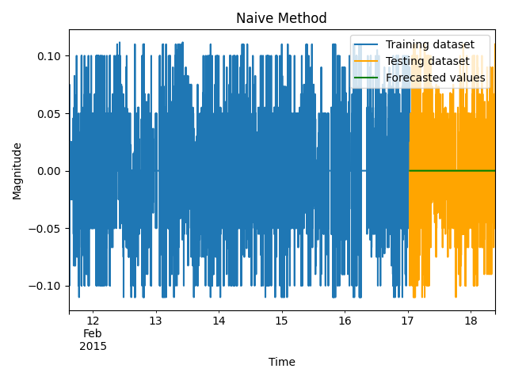
Naive Method
Q-Value: 957.818 (Critical: 36.19)
Mean of residual error: 0
MSE of residual error: 0.003
Mean of forecast error: 0.004
MSE of forecast error: 0.001
Variance of residual errors versus forecast errors: 2.98

Slide 21

Drift Method
Q-Value: 957.818 (Critical: 36.19)
Mean of residual error: 0
MSE of residual error: 0.003
Mean of forecast error: 0.004
MSE of forecast error: 0.001
Variance of residual errors versus forecast errors: 1.72

Slide 22
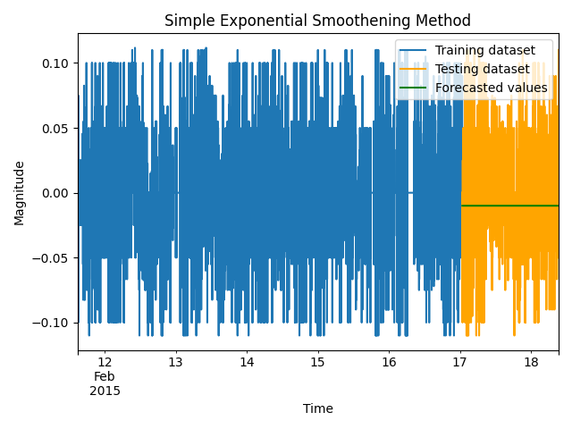
SES Method
Q-Value: 957.818 (Critical: 36.19)
Mean of residual error: 0
MSE of residual error: 0.002
Mean of forecast error: 0.002
MSE of forecast error: 0.010
Variance of residual errors versus forecast errors: 1.13

Slide 23
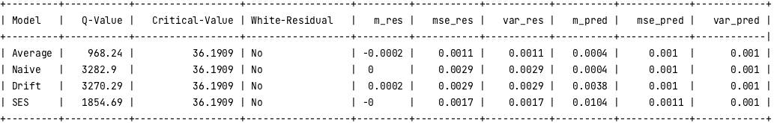
Base Model Comparison

Slide 24
Multiple Linear Regression

Slide 25
Feature Selection
We performed feature selection in three ways.
Backward Stepwise Regression: Using this method, the initial OLS model did not have any feature whose p-value is less than 0.05. Therefore, no features were dropped.
Variance Inflation Factor: Using VIF method the highest VIF score was observed for Humidity feature. But removing Humidity, degrades the OLS performance. Therefore, no features were dropped.
Principal Component Analysis: Using PCA method, we received 4 components and executed OLS model on those 4 components.

Slide 26
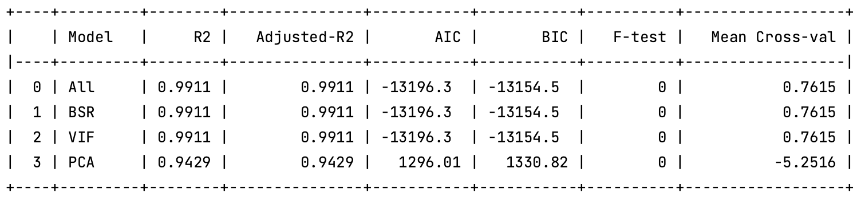
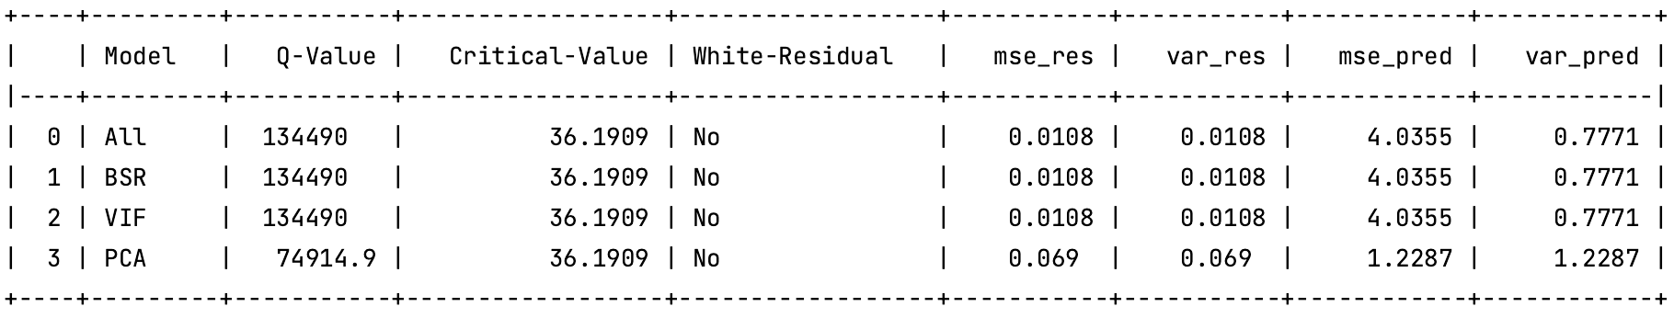
Model results from Feature Selection

Slide 27
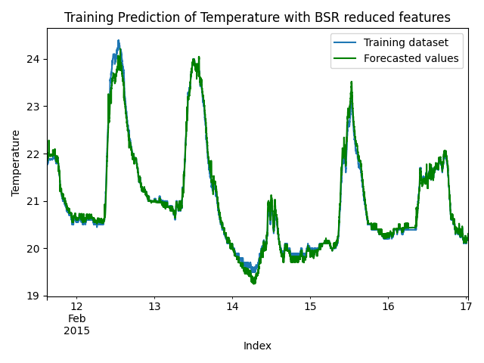
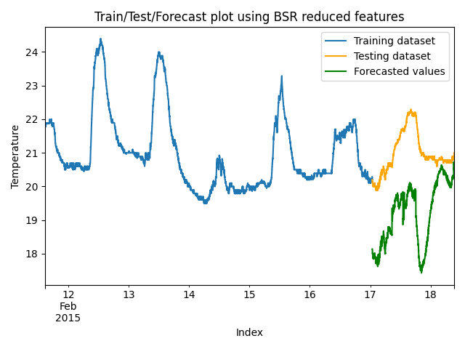
Plots for results using features from BSR

Slide 28
ARMA

Slide 29
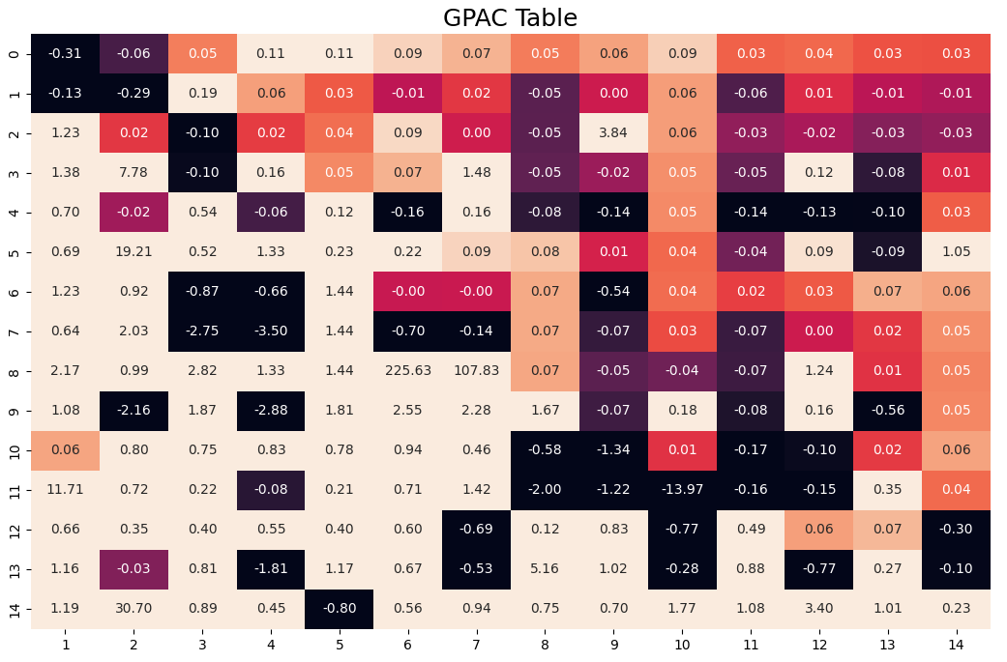
Order Determination using GPAC
Using GPAC table we can observe four order or AR and MA.
ARMA ( 5, 6)
ARMA ( 8, 1)
ARMA ( 10, 2)
ARMA ( 11, 7)
We then perform time series forecasting for the data using these three order.

Slide 30
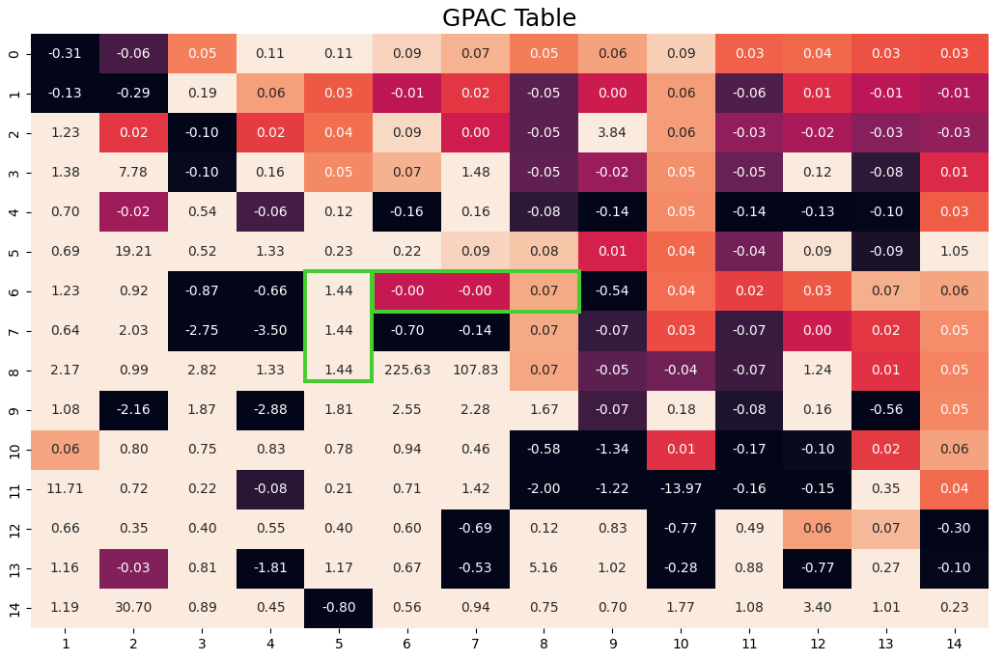
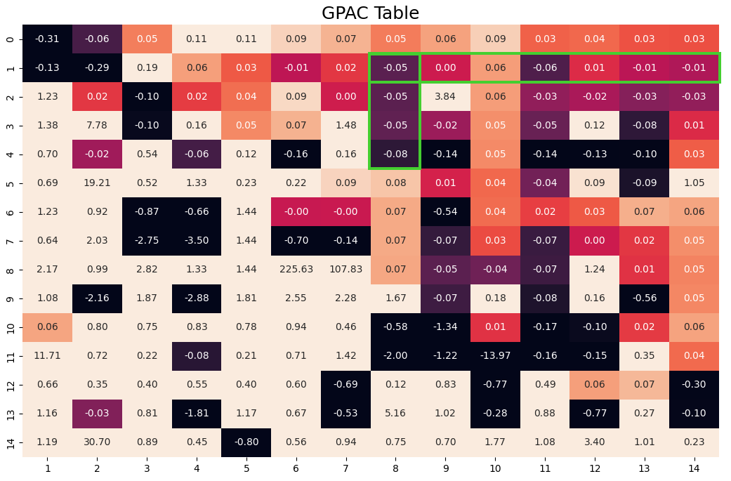
ARMA order from GPAC
ARMA(5,6)
ARMA(8,1)

Slide 31
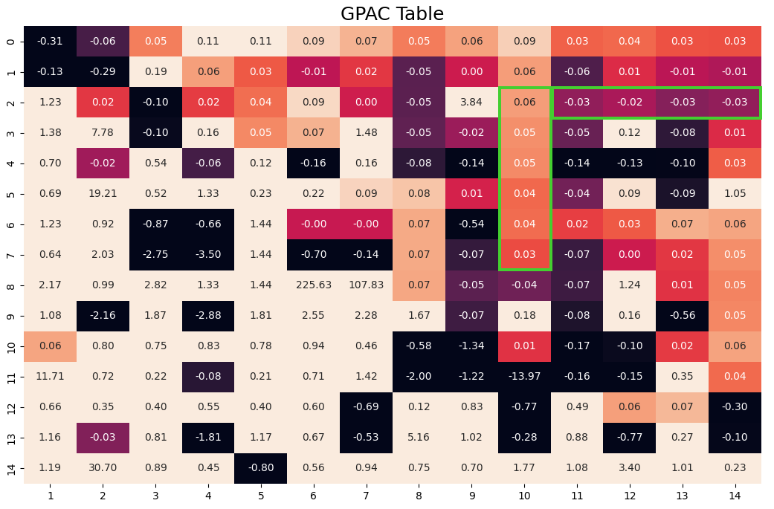

ARMA order from GPAC (continued)
ARMA(10,2)
ARMA(11,7)

Slide 32
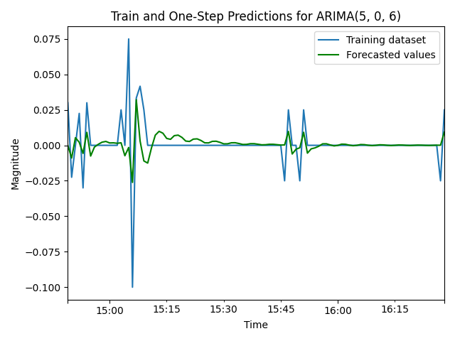
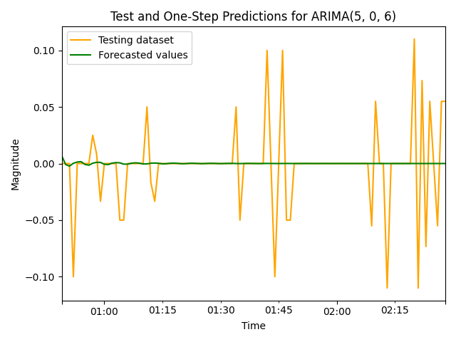
ARMA (5,6)

Slide 33
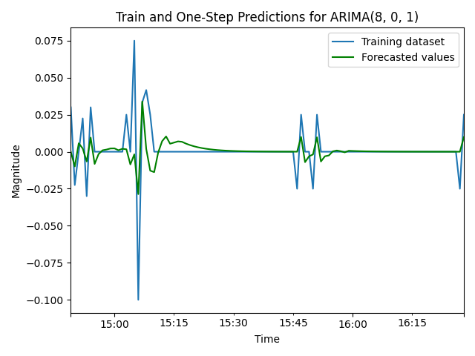

ARMA (8,1)

Slide 34


ARMA (10,2)

Slide 35
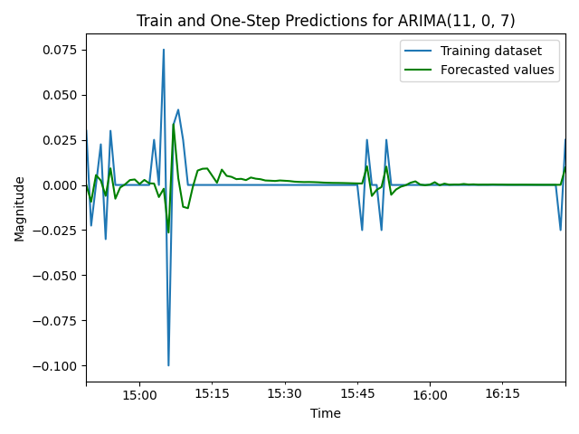

ARMA (11,7)

Slide 36
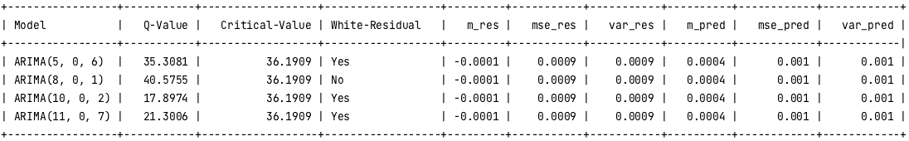
Model Results

Slide 37
Final Model Selection

Slide 38
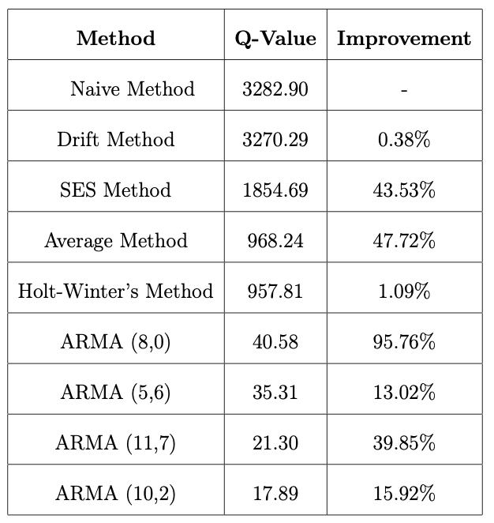
Model Comparison
ARMA(10, 2) exhibit the lowest Q value amongst all models indicating a comparable goodness of fit, with the residuals following a white noise pattern.
We can consider the Multiple Linear Regression model as the model explains 99% of the variance in the data, suggesting a good fit.

Slide 39
H-step ahead Prediction

Slide 40
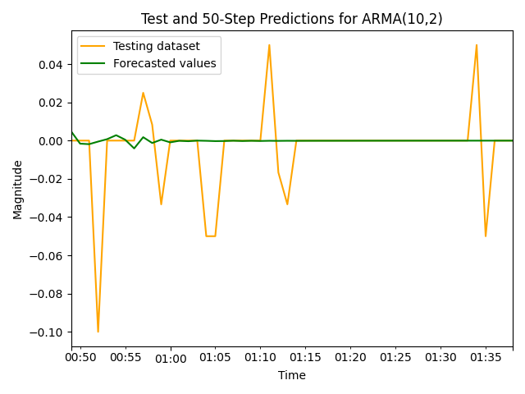

50-step and 100-step Prediction

Slide 41
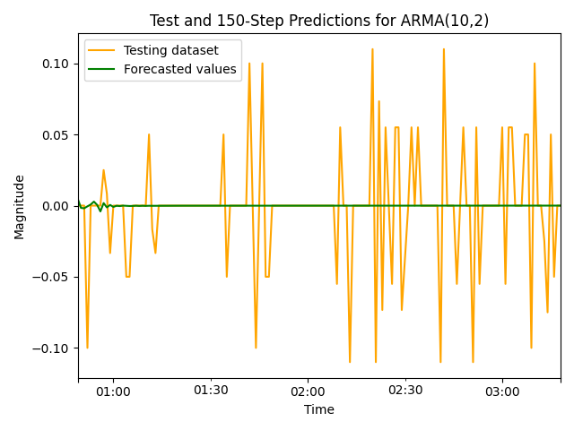
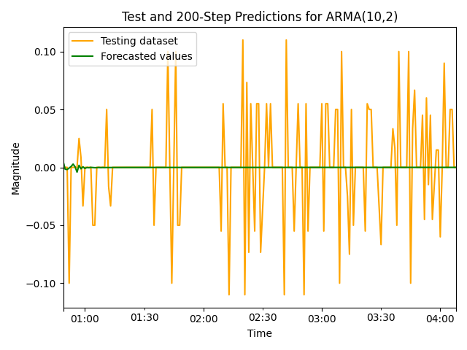
150-step and 200-step Prediction

Slide 42
Thank You

